Slide 1

Survey Insights: The Tools Driving Today’s Developers
Part 1
By Lovemore C. Jongomedzi
Data Analytics Student at IBM
June 2026

Slide 2



OUTLINE
Executive Summary
Introduction
Methodology
Results
Visualization – Charts
Dashboard
Discussion
Findings & Implications
Conclusion
Appendix

Slide 3

EXECUTIVE SUMMARY
This report presents insights from a technology usage survey visualized through IBM Cognos Analytics. It highlights the most widely adopted programming languages, databases, cloud platforms, and web frameworks among developers. The findings reveal dominant technologies shaping modern development practices and provide implications for future adoption trends.

Slide 4

INTRODUCTION
The purpose of this report is to analyze current technology preferences across key categories in software development. By examining survey data, the report identifies patterns in tool usage and adoption rates, offering a comprehensive view of the modern tech stack landscape.

Slide 5

METHODOLOGY
Data Source: The data source was downloaded from here: Link.
Data Preparation: The columns LanguageHaveWorkedWith, LanguageWantToWorkWith, DatabaseHaveWorkedWith, DatabaseWantToWorkWith, PlatformHaveWorkedWith, PlatformWantToWorkWith,WebframeHaveWorkedWith and WEbframeWantToWorkWith were split and exploded to create individual entries for each column. The developer survey dataset was then imported into IBM Cognos Analytics.
Visualization Tools: IBM Cognos Analytics dashboard features were used to generate bar charts and comparative visuals.
Analysis Approach: Top 10 technologies per category were identified based on frequency counts.

Slide 6
RESULTS
VISUALISATION– CHARTS
DASHBOARD

Slide 7
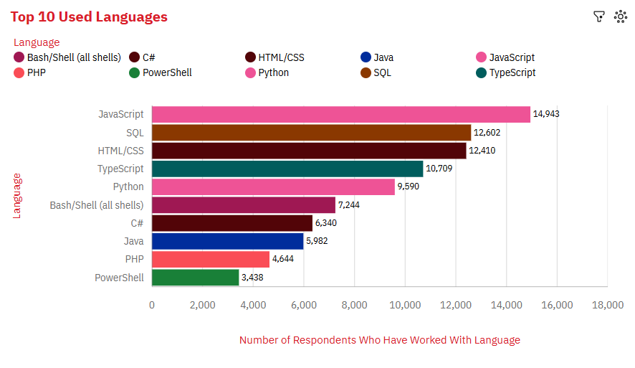
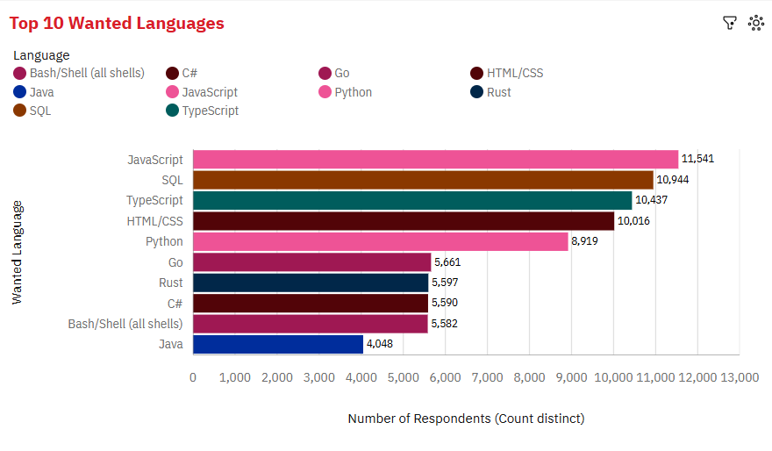
PROGRAMMING LANGUAGE TRENDS
Current Year
Next Year
< Bar chart of top 10 programming languages for the next year goes here.>

Slide 8
PROGRAMMING LANGUAGE TRENDS - FINDINGS & IMPLICATIONS
Findings
The number of respondents who have used JavaScript is the highest at nearly 15 thousand, followed by that of those who have used SQL at nearly13 thousand. This pattern remains the same for languages developers who want to work with the languages.
The number of respondents who want to use the current languages decreased.
Implications
JavaScript and SQL remain the most popular languages..
The popularity of the top 10 languages is decreasing.
HTML/CSS is losing popularity and position.

Slide 9
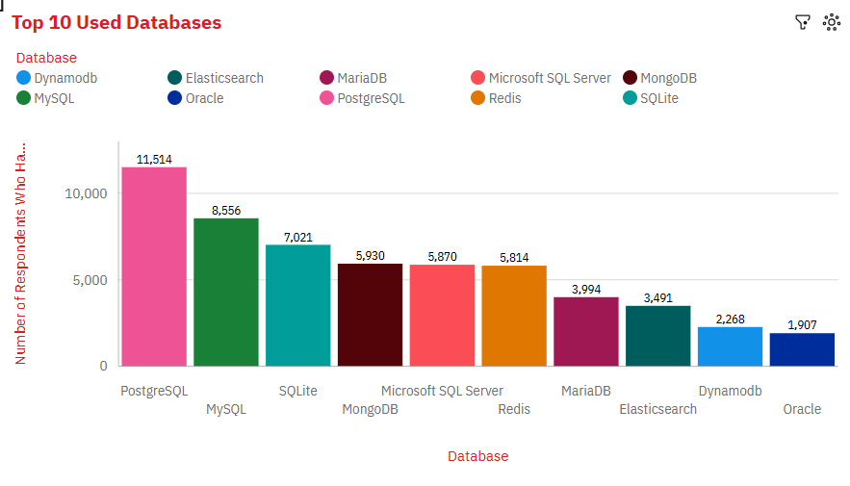
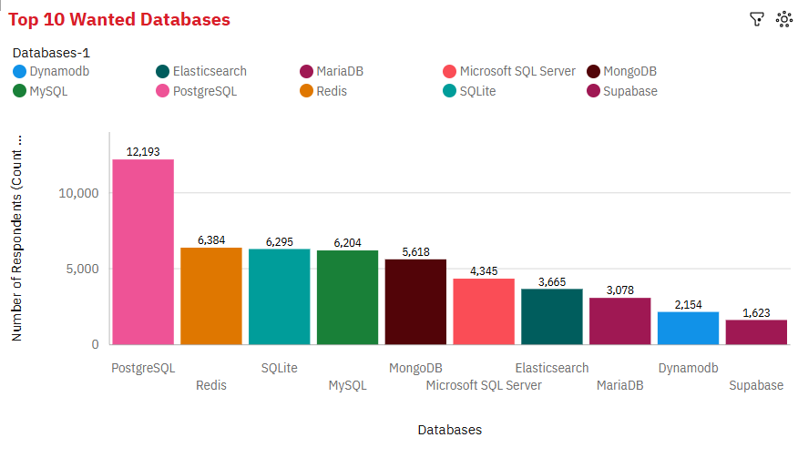
DATABASE TRENDS
Current Year
Next Year
< Bar chart of top 10 databases for the current year goes here >
< Bar chart of top 10 databases for the next year goes here.>

Slide 10
DATABASE TRENDS - FINDINGS & IMPLICATIONS
Findings
PostgreSQL has the highest number of respondents for the database used most and wanted most.
The number of respondents for Redis increased to nearly 6500 and its position improved.
Implications
PostgreSQL is the most popular database and its popularity is increasing.
Redis is increasing in popularity and position among databases.

Slide 11

DASHBOARD
https://eu2.ca.analytics.ibm.com/bi/?perspective=dashboard&pathRef=.my_folders%2FSurvey%2Bupdated%2Bdata%2Bdashboard&action=view&mode=dashboard&subView=model0000019eaa56f9a5_00000000&nav_filter=true
Copy
Embed code:
Width:
Height:

Slide 12
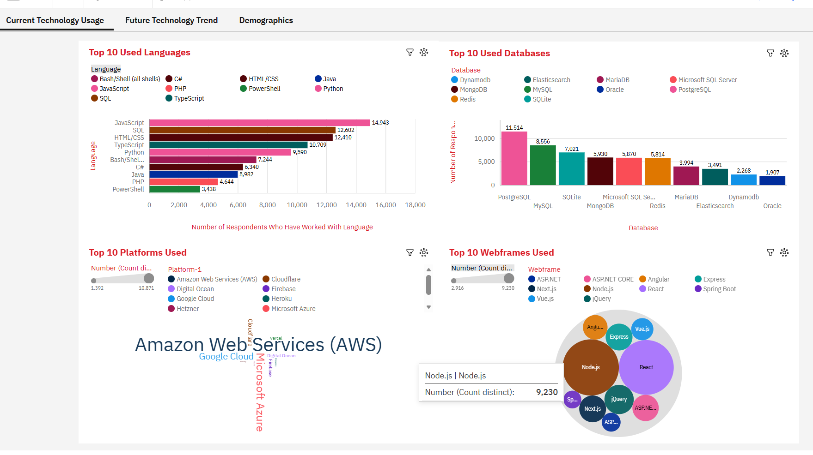
DASHBOARD TAB 1: CURRENT TECHNOLOGY USAGE

Slide 13
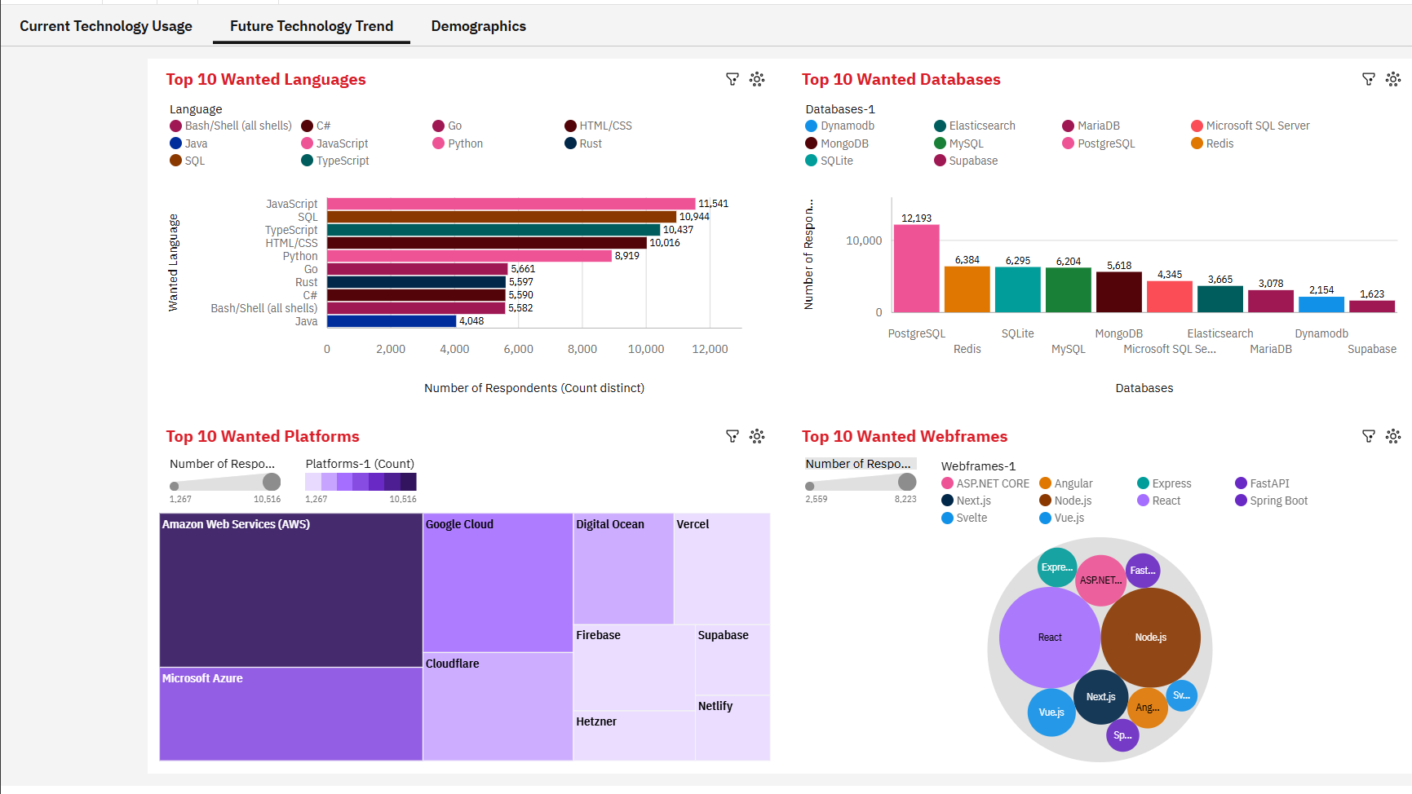
DASHBOARD TAB 2: FUTURE TECHNOLOGY TREND
Screenshot of dashboard tab 2 goes here

Slide 14
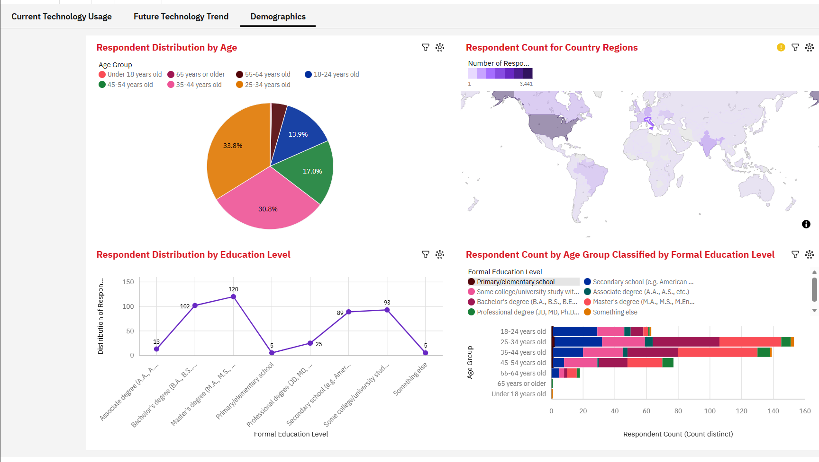
DASHBOARD TAB 3: DEMOGRAPHICS
Screenshot of dashboard tab 3 goes here

Slide 15
DISCUSSION
FINDINGS AND IMPLICATIONS

Slide 16
OVERALL FINDINGS & IMPLICATIONS
Findings
The tools used by developers show overall consistency in popularity.
However, some technologies are gaining ground.
Most respondents reside in the United States of America, are aged between 25 and 44 years and have either a Bachelor's or a Master's degree.
Implications
The current popular technology tools used by developers will continue to dominate in the short tem.
However , in the long term, they may be overtaken.
Development requires an active mind, a good education and a conducive environment.

Slide 17

CONCLUSION
Development requires an active mind, a good education and a conducive environment.
The current popular technology tools used by developers will continue to dominate in the short term.
However , in the long term, they may be overtaken.

Slide 18

APPENDIX

Slide 19
JOB POSTINGS

Slide 20
POPULAR LANGUAGES

